Slide 1

k prototypes Clustering for Mixed-Type Data
Gero Szepannek

Slide 2
Scope
Gold standard for clustering in industry:
K-means
Hierarchical Clustering (x-Linkage & Ward)
SOMs
…originally designed for numeric data.
For factors only…
… latent class analysis can be used (e.g. using {poLCA}; Linzer and Lewis, 2014)
The k modes algorithm extends k means to factors (cf. {klaR}; Roever et al., 2014)
But for most BI applications both are of interest: numerics and factors.
Common practice:
Hierarchical Clustering using Gower distance (e.g. using {cluster}; Maechler et al., 2016)
Pre-Transform of factors into dummies (cf. Weihs and Szepannek, 2010, e.g. using {caret}; Kuhn, 2016)
An alternative approach: k prototypes (Huang, 1998) generalizes k modes for mixed type data ({clustMixType}; Szepannek, 2016).

Slide 3
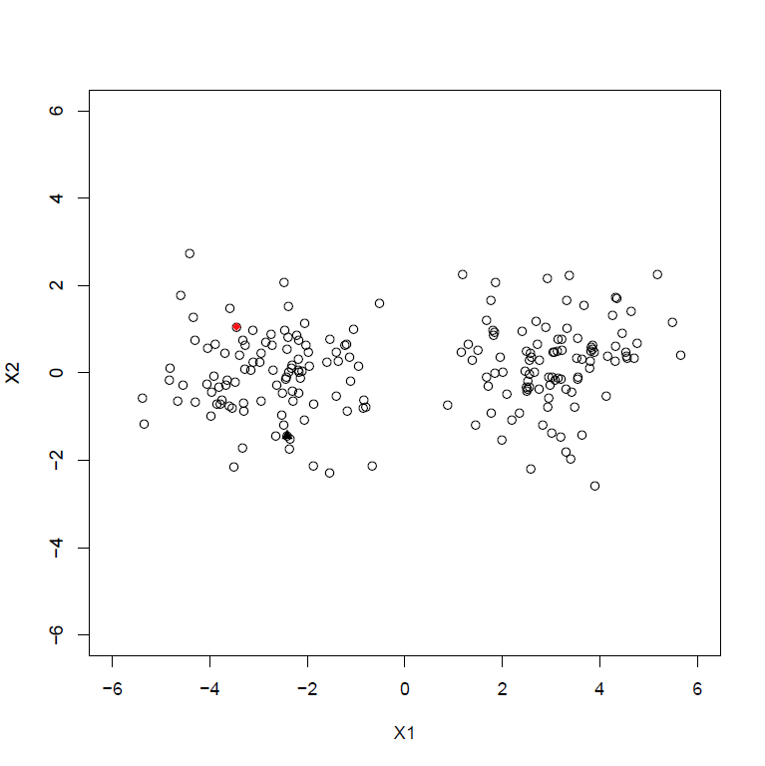
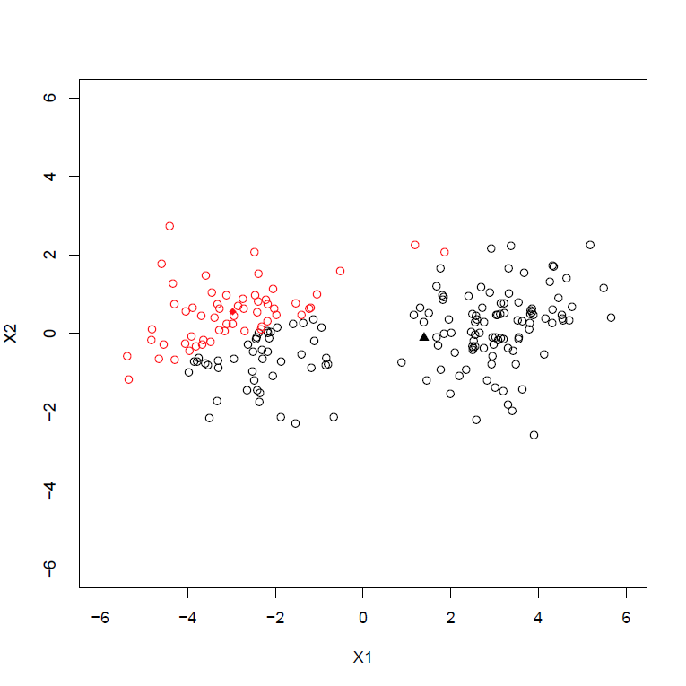
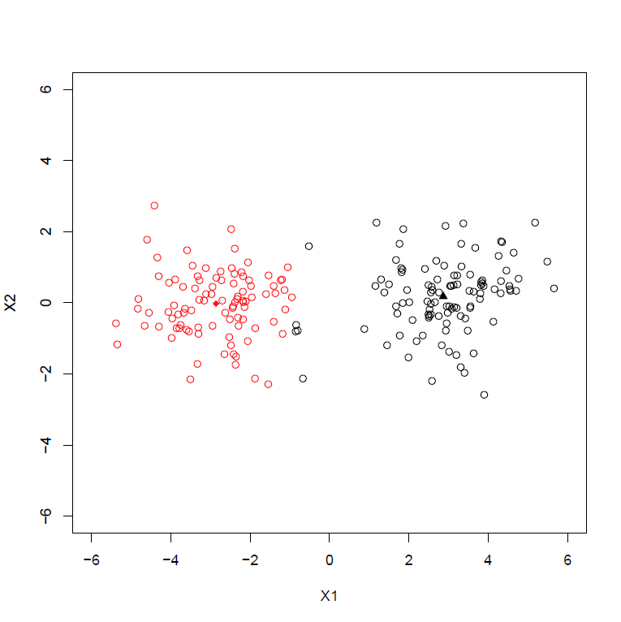
Basic k Means Algorithm
Initialize k centers.
Assignment of each observation to its closest center.
Cluster update of center as means according to the new assigmnent.
Repeat 2. and 3. until convergence or maximum number of iterations.

Slide 4

From k Means to k Prototypes
For numeric variables the cluster mean is the prototype with minimal euclidean distance to all objects (cf. e.g. Hastie et al., 2009).
Likewise for factor variables the mode minimizes simple matching distances, it is:
(number of objects different from x_{mode})
Both means and modes are calculated for each variable separately!
$$\sum_{i=1}^{n_{k}}{I\left(x_{i}≠x_{mode}\right)}=min$$
This allows do define a prototype update step in the mixed type setting.

Slide 5

Cluster Assignment
According to the former considerations a mixed-type distance is defined by:
…where the upper index j denotes the variable (p numerics and (q-p) factors)
The parameter λ allows to control the trade-off between numeric and factor variables in distance computation.
$$d_{mix}\left(x,y\right)=\sum_{j=1}^{p}{{\left(x^{j}−y^{j}\right)}^{2}+λ\sum_{j=p+1}^{q}{I(x^{j}≠y^{j})}}$$
According to d_{mix} in each step clusters will be re-assigned.

Slide 6

The Package clustMixType
The R package clustMixType (Szepannek, 2016) offers access to:
…a function kproto() to perform k prototype clustering
…a predict() method for application to new data,
…a function clprofiles() to visualize cluster profiles.
Basic call: kproto(x, k, lambda = NULL, iter.max = 100, nstart = 1)
creates an object of class kproto where
x is a data frame
k the number of clusters and (note that alternatively a vector of prototype indices can be passed)
lambda the control parameter (cf. last slide)
iter.max and nstart control termination of the algorithm and multiple calls (as the algorithm only locally converges it depends on initialization. The best solution of repetitve calls will be returned.)

Slide 7
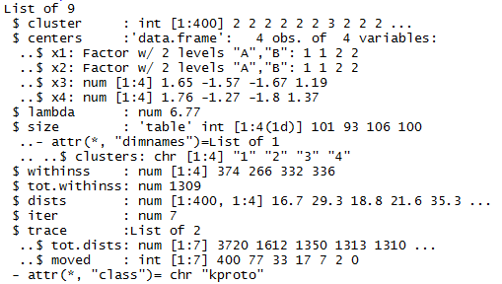
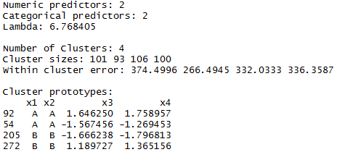
Example
Design:
4 clusters
4 variables (2 numeric, 2 factor)
100 observations | cluster
Cluster | Num1 | Num2 | Factor1 | Factor2
1 | + | + | + | +
2 | - | - | + | +
3 | + | + | - | -
4 | - | - | - | -
Result: kmeans like object of class kproto

Slide 8
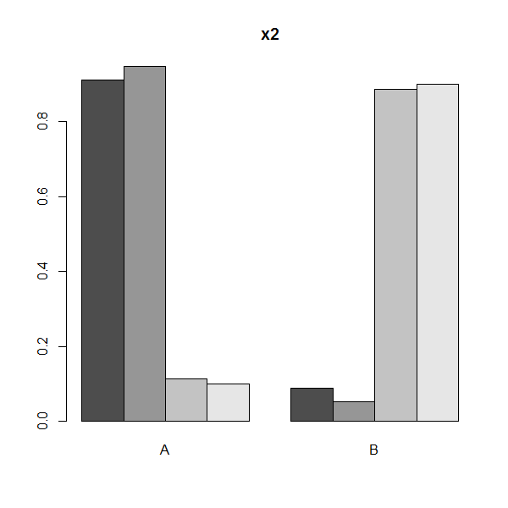
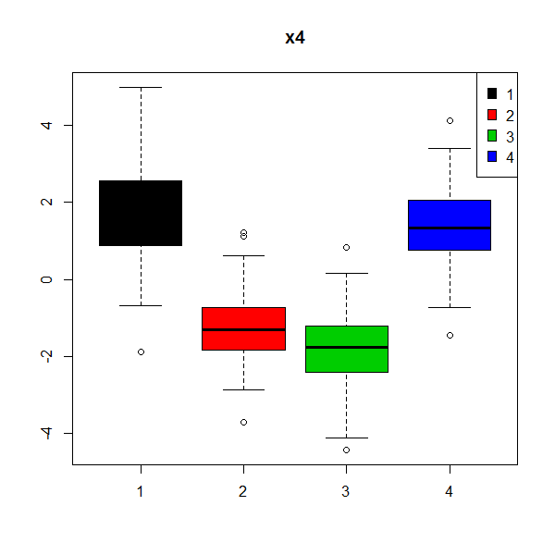
Profiling the Cluster Result…
Call: clprofiles(object, x, vars) ´ (where object is the result of kproto and x the data. …By vars a subset of variables can be specified for profiling.)

Slide 9
References
Huang, Z. (1998): Extensions to the k-Means Algorithm for Clustering Large Data Sets with Categorical Values, Data Mining and KDD 2, 283–304.
Hastie, T., Tibshirani, R. and Friedman, J. (2009): The Elements of Statistical Learning. Springer.
Kuhn, M. (2016): caret: Classification and Regression Training, R package version 6.0-71, https://CRAN.R-project.org/package=caret.
Linzer, D. and Lewis, J.. (2014): poLCA: Polytomous variable Latent Class Analysis, R package version 1.4-1, https://CRAN.R-project.org/package=poLCA.
Maechler, M., Rousseeuw, P., Struyf, A. Hubert, M. (2016): cluster: "Finding Groups in Data": Cluster Analysis Extended Rousseeuw et al, R package version 2.1-4, https://CRAN.R-project.org/package=cluster.
Roever, C., Raabe, N., Luebke, K., Ligges, U., Szepannek, G. and Zentgraf, M. (2014): klaR: Classification and visualization, R package version 0.6-12, https://CRAN.R-project.org/package=klaR.
Szepannek, G. (2016): clustMixType: k-Prototypes Clustering for Mixed Variable-Type Data, R package version 0.1-16, https://CRAN.R-project.org/package= clustMixType.
Weihs, C. and Szepannek, G. (2009); Distances in Classification, Transactions in Case-Based Reasoning 2, 3-14.

Slide 10
Thank you!

